Slide 1
Demo Setup

Slide 2



Secrets Access Workflow
Requestor
Conjur Follower
Target
Authenticate
Access Token
Access per Policy
Retrieve secrets
Use secrets
Access Token expires after 8 mins
Audited activity

Slide 3
Conjur K8s Demo Architecture
Windows Hosts
(my Mac)
CyberArk Enterprise Password Vault
Synchronizer
Linux Host
(my Mac)
L
Minikube K8s Cluster (my Mac)
cyberark Namespace
user1 Namespace
F
Authen-ticator
Demo App
Service
Service

Slide 4
Dynamic Access Provider (Conjur) OCP4 Lab Architecture
Windows Hosts
CyberArk Enterprise Password Vault
Synchronizer
Linux Host
L
OCP4 Cluster (AWS)
cybrlab Namespace
User Namespaces
F
Authen-ticator
Lab App
Service
Service

Slide 5
Encryption-as-a-Service

Slide 6

Thales Cipher Trust & Cyberark conjur
Thales Cipher Trust Solution provides:
On Demand Encryption/Decryption
Data Tokenization
Transparent Database Encryption
Workflow:
CyberArk CPM manages the Thales CipherTrust password.
Apps authenticate to Conjur to retrieve the Thales CipherTrust password, gaining access to encryption services and keys.
Together, the Thales CipherTrust Solution and CyberArk Secrets Manager are the best-of-breed solution for ephemeral data protection needs.
Solution page: https://cpl.thalesgroup.com/encryption/data-security-platform

Slide 7



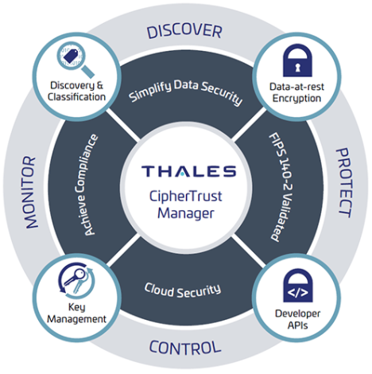
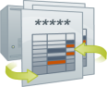

Thales/Cyberark integration workflow
CyberArk CPM manages the CipherTrust password.
The password is synchronized to CyberArk Conjur.
The Application authenticates to Conjur and retrieves the CipherTrust password.
The Application Logs into CipherTrust to complete encryption/tokenization tasks.
2
CyberArk Vault
Conjur
3
Application
1
4
Central Policy Manager

Slide 8
Developer Experience

Slide 9
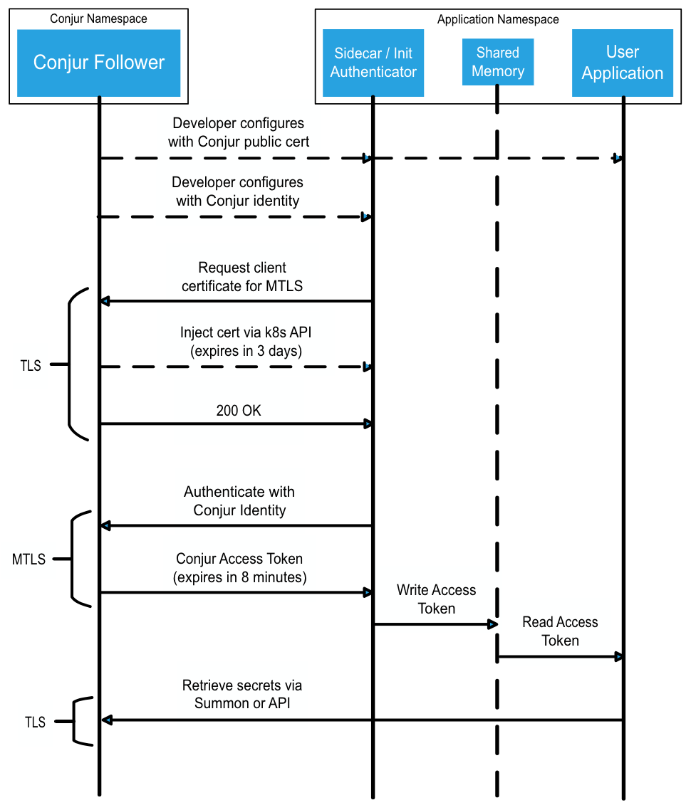
Openshift/ K8s authn flow
CyberArk Conjur Service
authentication client container
Shared memory volume
application container
Deployment
manifest
Login
Authentication
Secrets retrieval

Slide 10



Useful Concepts
SEP Risk Assessment Model
Segregation of Duties
Least Privilege
Risk = Severity x Exposure x Probability (R = S x E x P)
An internal control designed to prevent error and fraud by ensuring that at least two individuals are responsible for the separate parts of any task.
Only the minimum necessary rights should be assigned to a subject that requests access to a resource and should be in effect for the shortest duration necessary.
Notes:
Severity: Describes the potential loss or consequence or a mishap.
Exposure: The amount of time, number of cycles, number of people and resources (equipment) involved.
Probability: The likelihood that given the Exposure, the projected consequences will occur. Training, situational awareness, morale and attitude change are used to mitigate Probability.

Slide 11
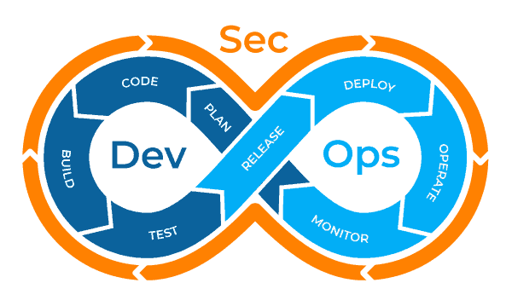
DevSecOps Integrated
Notes:
There are many graphics that you may find when doing a Google search for devsecops, but this is my favorite, because it really shows the need for security to be involved in the entire process.
“Security at Inception”:
Will deliver more secure code
Reduce the amount of time required to respond to incidents
Reduce the amount of time spent refactoring code due to security requirements
Reduce or eliminate the amount of time spent pushing new copies of secrets manually to disparate credential stores
All of this recovered time can be spent providing more value to your end customers, regardless of if that is the American public, or the Warfighters that you support.
DevSecOps takes DevOps one step further, it integrates security into the entire process of DevOps
Each of the steps that were described before, building, testing, releasing all require some level of privilege.
Your Ansible Playbook requires privilege to:
Update the system
Patch the systems
Copy/release/reinstall code
Build infrastructure
Your testing tool requires privilege to:
Login to the test environment
Run tests with the code
Your Ci/Build tools require privilege to:
Build the code
Deploy the code

Slide 12
Conjur OpenAPI Spec
Documents and describes the Conjur API in a machine-readable standard, OpenAPI Specification v3
Successor to Swagger
Swagger 2.0 was donated to the OpenAPI Initiative in 2015, included in the OpenAPI Specification v3.0 onward
Benefits to Customers
Multi-language support
Allow users to generate Conjur client libraries for their own use
If a user is trying to incorporate Conjur into their project for which CyberArk does not offer an official client, customers can generate a client from the OpenAPI spec instead of writing their own client/wrappers/HTTP requests
Integrations
Can be used to configure API gateways, eg.
AWS Gateway (https://docs.aws.amazon.com/apigateway/latest/developerguide/http-api-open-api.html)
Apigee (https://docs.apigee.com/api-platform/publish/specs/intro)
Can be imported to Postman for API experimentation/discovery
Benefits to CyberArk
Documentation
Single source of truth for the Conjur API
Development on the OpenAPI spec proved fruitful - we were able to document HTTP responses that weren’t previously, as well as specifying edge cases on a few endpoints that can take multiple URL parameters
Can use the OpenAPI description to generate human-readable documentation
Can generate Markdown/HTML documentation
Interactive API documentation with Swagger UI (https://swagger.io/tools/swagger-ui/)
Generated REST clients
Makes the Conjur SDK simpler to maintain
Previously, making a change to the Conjur API would mean each individual Conjur SDK would have to be updated with hand-crafted updates
If the Conjur SDK was generated from the OpenAPI spec, updating these clients would be as simple as generating a new batch of clients from the OpenAPI description

Slide 13
Secretless

Slide 14
The Secrets Lifecycle Today
Secrets Storage
Secrets Delivery
Applications

Slide 15


“Secretless” concept: Apps can’t leak secrets
LDAP, htpasswd, etc.
2
4
Conjur Follower
User authn
K8s Pod
HTTP Request
1
3
User (Simulated)
Billing Service
Secretless
Database
Service connects to Secretless proxy
Secretless establishes a connection to the remote database and transparently brokers the connection
1
3
Secretless proxy requests database credentials to remote database
Conjur seamlessly rotates database credentials used by Secretless
2
4

Slide 16


“Secretless” Security Management Centralized Governance & Workflows
Secretless
Server
Traffic Analysis
Notify and respond to abnormal traffic patterns
Traffic Filtering
Blacklist certain keywords or message types sent from the client
Access Restrictions
Based on time, service type, geography or human intervention
Streamlined application onboarding workflows
Out of the box or plugged into your existing ticketing system
Detailed audit logs and metadata aggregation
Provide deep context to facilitate faster, well-informed decision making
Reporting & Policy
Enforcement
Request
Authenticated Request
Client Application
Secretless

Slide 17
Policy Reference Model

Slide 18
Policy Reference Model
Managed by Conjur admin process
Managed by Synchronizer
Managed by Conjur admin process
/
conjur
Vault
appteam1
appteam2
authn-k8s
SyncTag1
consumers
consumers
cluster-id
appteam1-safe
hosts
hosts
authn-azure
appteam2-safe
tenant-id
Managed by project admin process

Slide 19
Identity definition & permissions grants by app teams
Managed by privileged Conjur admin (process):
Managed by app team admin:
#======================
# APPTEAM1 ROOT POLICY
# AppTeam Policy Template where policy namespace = EPV safe name
# Creates admin identity to delegate policy mgmt and role to grant authn to app identities.
# This policy must be bulk-loaded with other root policies.
# Create one policy for each application team, named for the application team.
#======================
# Admin identity w/ CIDR limitation
- !host
id: appteam1_svc
restricted_to: 172.17.0.3
# Create root policy for appteam1
- !policy
id: appteam1
owner: !host appteam1_svc
body:
- !group consumers
# Grant cross-platform authn to appteam1/consumers role
- !grant
roles:
- !group conjur/authn-iam/lab/consumers
- !group conjur/authn-azure/lab/consumers
- !group conjur/authn-k8s/lab/consumers
- !group LabVault/Labs/LabSafe1/delegation/consumers
members:
- !group appteam1/consumers
# END APPTEAM1 ROOT
#======================
# APPTEAM1 IDENTITIES
# Policy defined & managed by the application team.
# Defines application identities “under” the app team’s root policy.
# Applied using appteam1_svc account at /appteam1 w/ --replace
#======================
- &hosts
- !host aws-app/475601244925/GenericReadOnly
- !host
id: azure-app
annotations:
authn-azure/subscription-id: a01ff134-ae78-4497-b11c-7a698736b8a0
authn-azure/resource-group: appteam1
authn-azure/user-assigned-identity: appteam1-UA-Identity
- !host
id: k8s-app
annotations:
authn-k8s/namespace: appteam1
authn-k8s/service-account: appteam1-app1
authn-k8s/authentication-container-name: authenticator
- !grant
role: !group consumers
members: *hosts
# END APPTEAM1 IDENTITIES

Slide 20
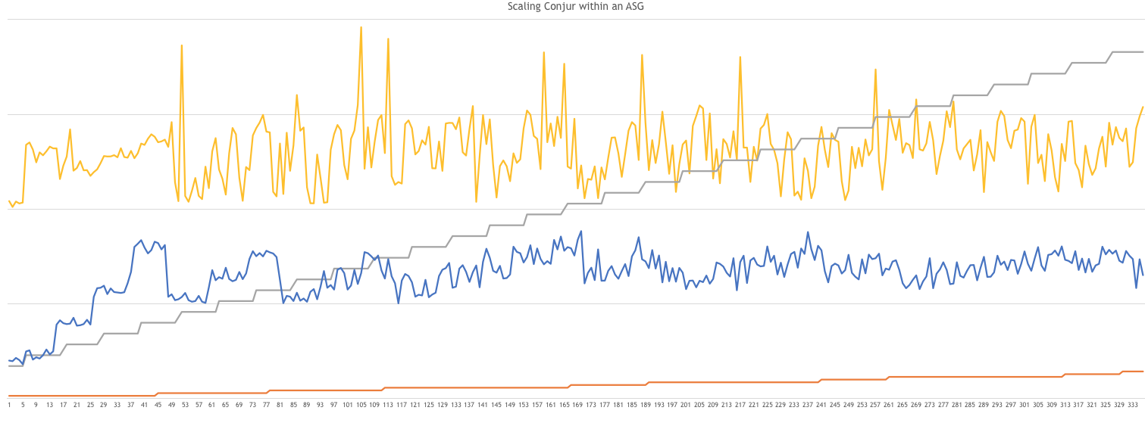
Elastic Scale Out Performance
140
105
70
35
0
Read Requests
(each step = 20/sec)
# Followers
Avg CPU%
Avg Latency (ms)

Slide 21
Production ocp deployment - performance
4 clusters, retrievals/hour/cluster w/ application cache (hash table, 15 min TTL)

Slide 22
Production OCP deployment – resource consumption
1 of 4 clusters, 5 followers/cluster

Slide 23
Next Steps…

Slide 24
Azure Authentication Details

Slide 25
Authn-Azure: Identity validated by Azure
Instance Metadata Service (IMDS)
http://169.254.169.254/metadata/identity/oauth2/token?api-version=2018-02-01&resource=https://management.azure.com/
Issues Azure access tokens (jwt)
Validates Azure access tokens for identities in Tenant
Tenant(s)
Provider URI: https://sts.windows.com/<tenant-id>
Subscription(s)
Resource Group(s)
“Group” Identity
CyberArk Conjur
System-Assigned Identities
User-Assigned Identities

Slide 26
Authn-k8s: Identity validated by K8s
Cluster(s) Conjur Authenticator ID
Namespaces(s)
Namespace
Identities
Deployment(s) Stateful Set(s) Daemon Sets(s) Replica Set(s) Pod(s)
etc.
Service Account Identities

Slide 27
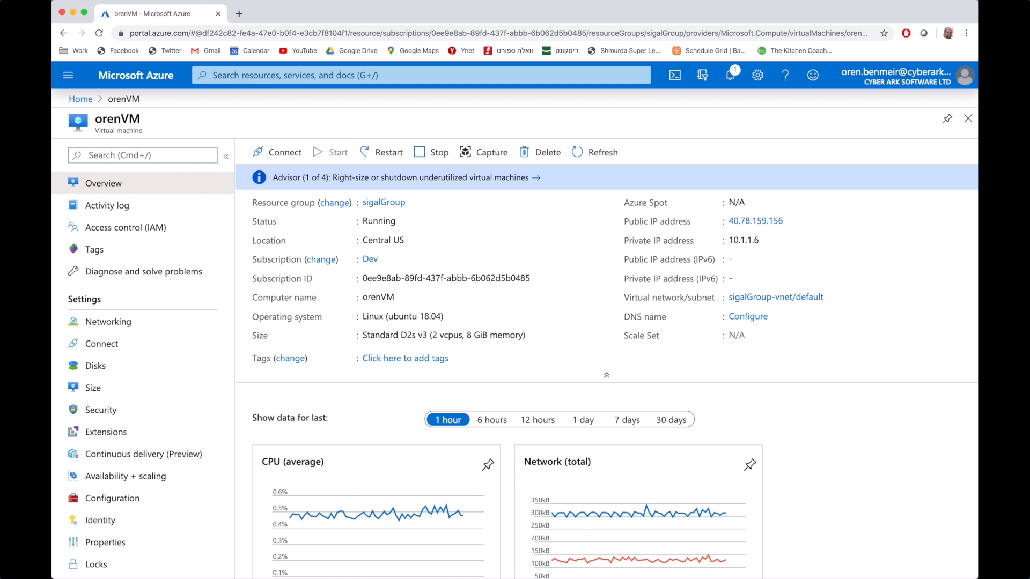
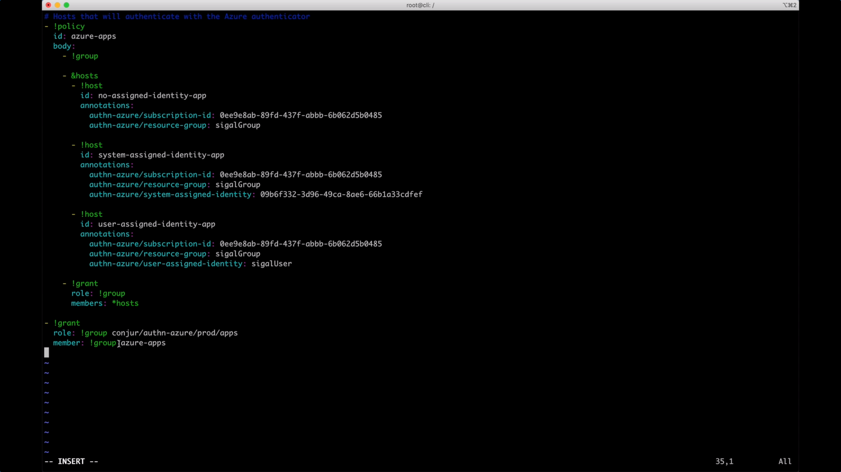
Azure Identity Option 1:
Subscription ID + Resource Group
Identity definition in Conjur Policy yaml:

Slide 28
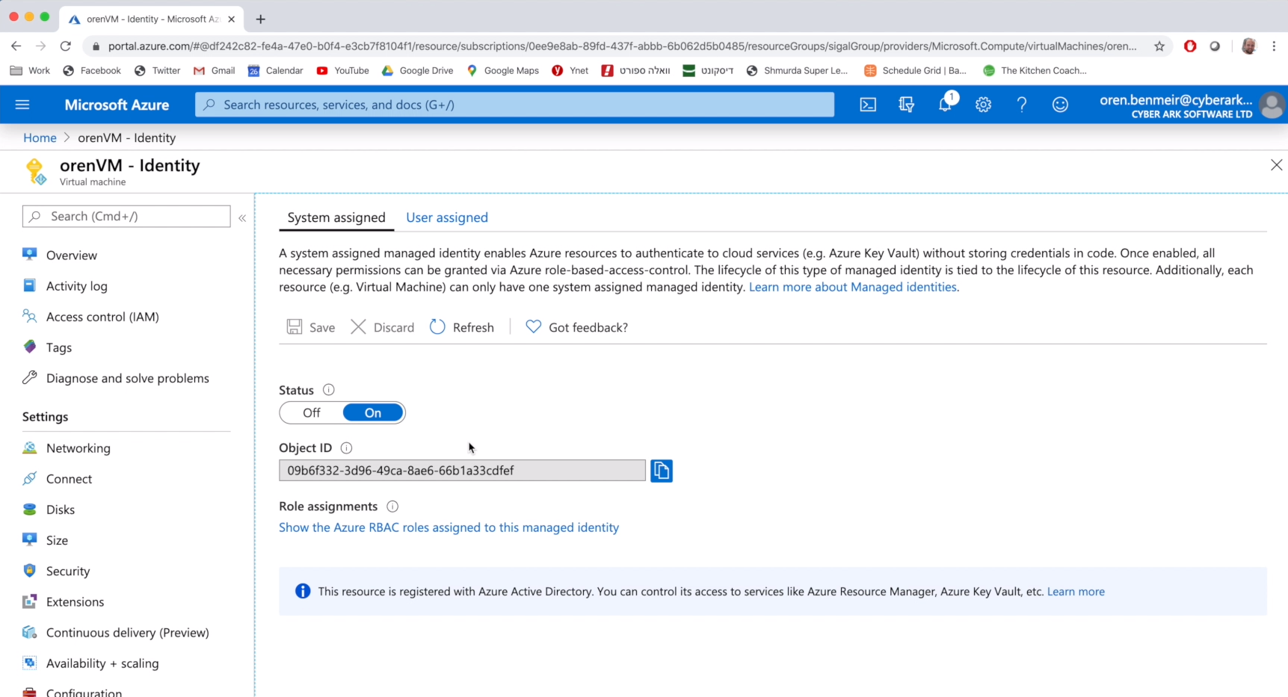
Azure Identity Option 2:
Subscription ID + Resource Group + System Assigned Identity
Identity definition in Conjur Policy yaml:

Slide 29
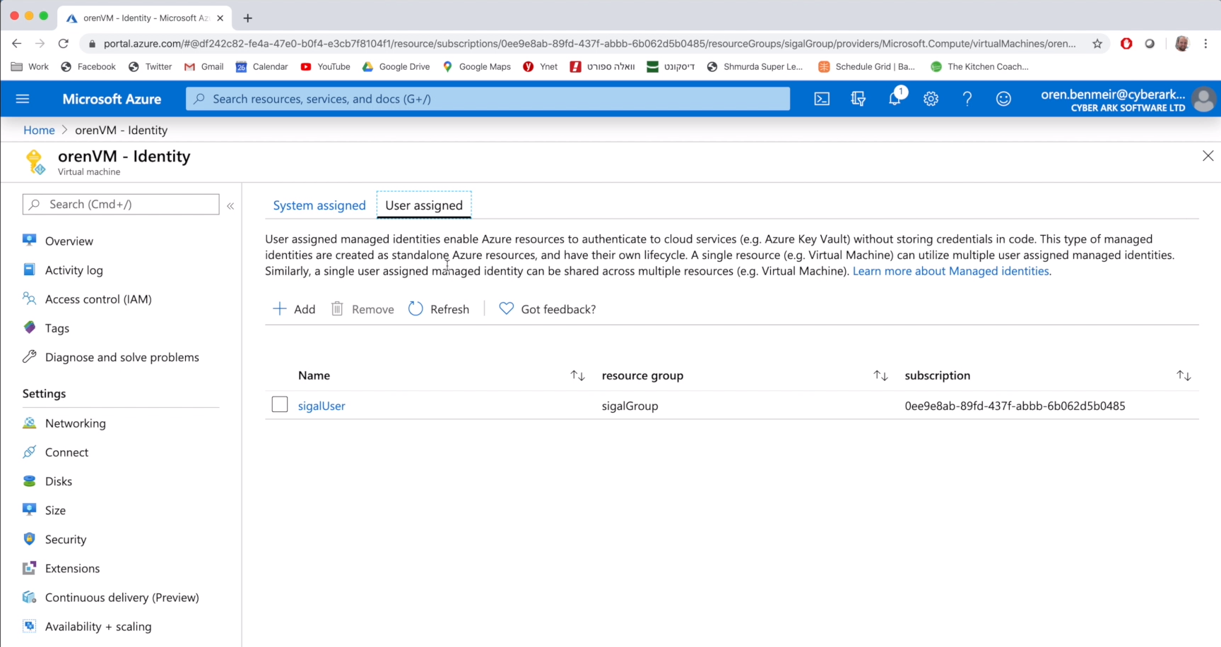
Azure Identity Option 3:
Subscription ID + Resource Group + User Assigned Identity
Identity definition in Conjur Policy yaml:

Slide 30
Policy Detail: Configure Azure authenticator ID named “prod”
---
- !policy
id: conjur/authn-azure/prod
body:
- !webservice
- !variable provider-uri
- !group
id: apps
annotations:
description: Role for authn to authn-azure/prod webservice
- !permit
role: !group apps
privilege: [ read, authenticate ]
resource: !webservice
Create Azure authentication webservice endpoint named “prod”
Define variable to hold https://sts.windows.net/{tenant-id}
Define prod/apps role
Permit apps group role to authenticate to
conjur/authn-azure/prod webservice

Slide 31
Policy Detail: Identity Definitions
---
- !policy
id: my-apps
body:
- !group
- &my-hosts
- !host rgrp1
annotations:
authn-azure/subscription-id: a01ff134-ae78-4497-b11c-7a698736b8a0
authn-azure/resource-group: JodyTest
- !host rgrp1-sid1
annotations:
authn-azure/subscription-id: a01ff134-ae78-4497-b11c-7a698736b8a0
authn-azure/resource-group: JodyTest
authn-azure/system-assigned-identity: 48268f7c-9470-4aff-97a9-fa6c736479f1
- !host rgrp2-uid1
annotations:
authn-azure/subscription-id: a01ff134-ae78-4497-b11c-7a698736b8a0
authn-azure/resource-group: Conjur-Demo
authn-azure/user-assigned-identity: Conjur-demo-UA-Identity
- !grant
role: !group
members: *my-hosts
- !grant
role: !group conjur/authn-azure/prod/apps
member: !group my-apps
Create Azure Identities
Grant my-apps group role to Azure Identities
Grant prod/apps role to azure-apps role

Slide 32
Policy Detail: Resource definition & access grant
---
- !policy
id: secrets
- !group consumers
- &vars
- !variable sub1-rgrp1
- !variable rgrp1-sid1
- !variable rgrp1-uid1
- !permit
role: !group consumers
privilege: [ read, execute ]
resource: *vars
- !grant
role: !group secrets/consumers
member: !host my-apps/rgrp1
- !permit
role: !host my-apps/rgrp1-sid1
privilege: [ read, execute ]
resource: !variable secrets/rgrp1-sid1
- !permit
role: !host my-apps/rgrp1-uid1
privilege: [ read, execute ]
resource: !variable secrets/rgrp1-uid1
Create secrets/consumers group
Create secrets (AKA variables)
Grant consumers read/exec access
Grant consumers role to resource group identity
Grant specific identities access to specific secrets

Slide 33
Crypto Details
Data at rest:
Database encryption uses 256-bit AES.
Master keys are encrypted with 256-bit AES.
Signed tokens use asymmetric RSA with 2048 modulus.
Password hashing is done with one-way bcrypt, with a work factor of 12.
Data in motion:
All access uses HTTPS (UI and API calls)
TLS 1.2 protocol only. No older TLS or SSL protocols supported.
Lowest strength cipher key size that can be negotiated is 128-bit, highest is 256-bit.
Diffie-Hellman key exchange within TLS sessions uses 3072-bit discrete logarithm group size, or 256-bit elliptic curve.

Slide 34
Pivotal Cloud Foundry

Slide 35

Pivotal Cloud Foundry
Industry leading Platform-as-a-service.
Enables high velocity continuous delivery of applications.
Simplifies operations by offering a nearly complete ecosystem for developing applications.
Large footprint in the enterprise. Customers include CITI, The Home Depot, JPMC, Boeing, and many more
Notes:
Key takeaway: CyberArk and Pivotal are working together to secure Pivotal Cloud Foundry.

Slide 36
Key Benefits
Secrets managed by CyberArk and Conjur are delivered securely to applications running in Pivotal Cloud Foundry
No developer impedance. Seamlessly integrated into the PCF Environment and Developer Workflow.
Security teams enabled to bring security best practices to PCF and meet compliance requirements

Slide 37
Components
Open Service Broker Within the Pivotal Cloud Foundry ecosystem, the Service Broker pattern has emerged as the standard for integrating services. The Service Broker pattern implements the Open Service Broker API standard it is backed by the Linux Project Foundation.
Summon Buildpack Buildpacks provide framework and runtime support for apps. Buildpacks typically examine your apps to determine what dependencies to download and how to configure the apps to communicate with bound services. The Summon Build Pack installs and configures Summon. Summon is a an lightweight, open source tool provided by CyberArk for securely injecting secrets into a process.
Conjur Conjur is an enterprise-ready secrets management solution for cloud and DevOps environments. Open source version of Conjur is available at conjur.org.

Slide 38
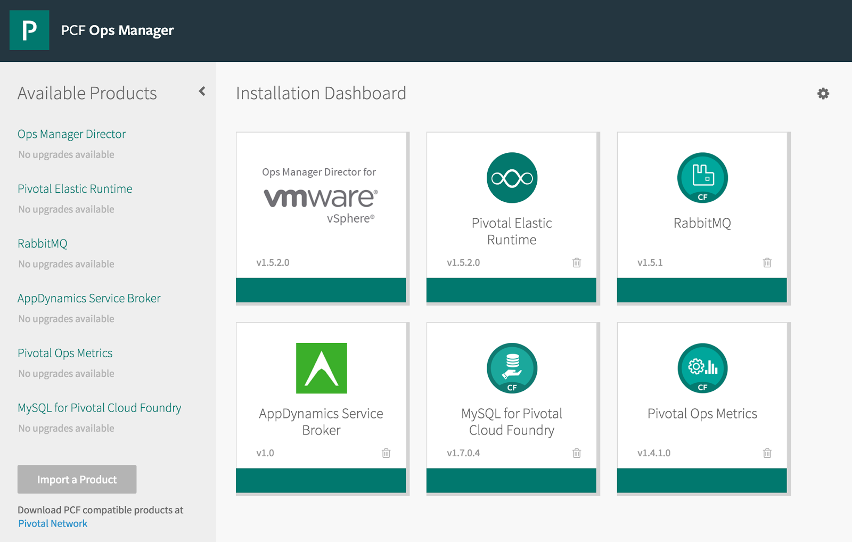
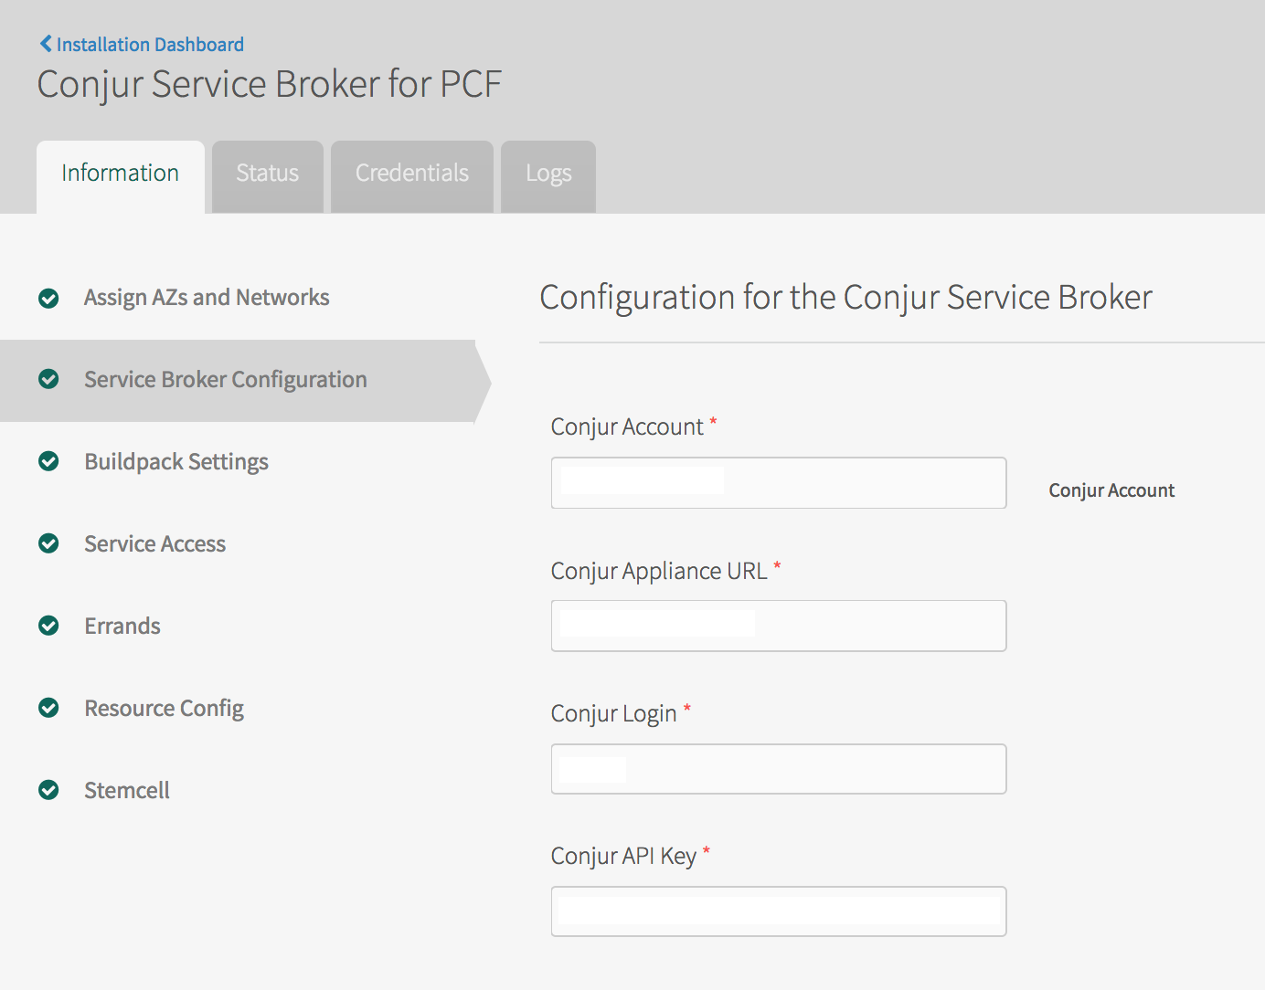
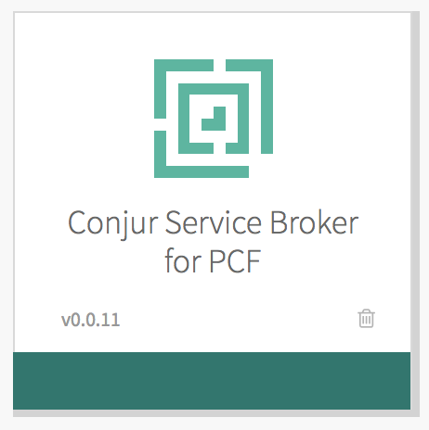
Service is installed and configured via the Ops Manager
Installing and Configuring CyberArk Conjur Service Broker for PCF
Notes:
Key takeaway: Install the Conjur service like you would any other PCF service.

Slide 39
Developer Workflow
Prepare the Application by adding a secrets.yaml file with references to the secrets your application needs.
Create a service instance in the space where you intend to deploy the application.
Add the instance name to your application manifest (if you are using manifest)
Push the application without starting it
Update Conjur policy grants with binding id for your application
Restage the application
Using CyberArk Conjur Service Broker

Slide 40
Under The Hood
Pivotal Cloud Foundry
4 Create Identity for Application
CyberArk Conjur Tile
1. Install & configure the service with the Conjur tile
CyberArk-Conjur Service Broker
Summon Buildpack
5. Issue credentials
6. Pass credentials
3. Bind Application to Service
CyberArk-Conjur
Follower Instance
2. When the application is started for the first time the Buildpack installs Summon
Application
8. Authenticate and request values
7. UpdateConjur policy to grant secret access to the app’s identity
CyberArk Summon
9. Inject secret values
Notes:
The source of a Conjur hostname in PCF (e.g. pcf/54ddaf3b-1ff6-488e-bdab-655f84b3ffbe) is the binding ID, which is unique to the application's Service Instance's binding to the Conjur Service Broker. The Service Instance and binding ID are created when the application binds to the Service Broker on initial push. The host identity is dynamically created in Conjur using a host factory, with the hostname name as "pcf/<binding ID>" and an associated API key. Those credentials (hostname & API key) are cached as part of the application's environment in the VCAP_SERVICES environment variable credentials attribute. The binding ID is unique to the push of the app, which may have multiple instances sharing the same Service Instance and using the same hostname/API key for Conjur authentication (i.e. the application instances all share the same identity). Restarting an app instance or deploying new instances doesn't refresh the binding. That only changes if the app is explicitly unbound from the service instance and is subsequently re-pushed (see https://docs.cloudfoundry.org/devguide/services/managing-services.html#unbind).

